Slide 1
Check this out... WAYS TO REDUCE CART ABANDONMENT ON SAMSUNG.COM
University of Louisville MSBA Spring 22 Cohort A

Slide 2



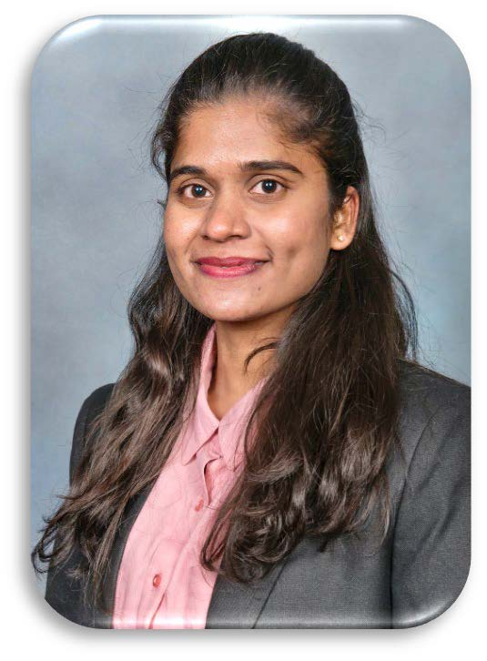
MEET OUR TEAM
Yashaswi Vedamurthy
Brittany Sweet
Jiasheng Liu
Vineetha Dareddy

Slide 3
AGENDA
Problem Statement
Executive Summary
Data Understanding
Cart Abandonment Rate (CAR) Definition
Model Data Design
Modeling Approach & Results
Important Drivers of CAR
Deep Dive into Important Drivers
Insights
Recommendations
Key Takeaways

Slide 4
Problem Statement
Currently, Samsung.com’s cart abandonment rate (CAR) is around 90%. At the same time, the industry average is between 70-80%. The goal of Samsung’s management team is to reduce the cart abandonment rate to 80-85%.
Our approach in short
Identify clusters of visits which have above average CAR, Understand the reason, strategize to reduce CAR of these clusters

Slide 5
Executive summary
VISTS WITH NO CHECKOUT EVENT IN THEM HAVE HIGH CAR
PREMIUM TV`S HAVE HIGH CAR WITH HIGHLY INTERESTED CUSTOMERS
VISITS WERE ABANDONED AFTER CHECKING THE REVIEW SECTION
VISITS WITH HIGHER CLICK DEPTH [1-(#VISITS / # ACTIVITIES)] HAVE LOWER CAR AND HIGHER AVERAGE SESSION TIME
VISITS COMING FROM GOOGLE SEARCH ONLY LAST ~4 MINUTES ON AVERAGE
~60% OF THE TOTAL VISITS LAST ONLY UP TO 10 MINUTES SESSION TIME

Slide 6
visit journey and cart abandonment
Visitor 1
Model Objective
Identify Important factors associated with CAR
Visit v-2
Visit v-1
Visit v
Visit v+1
Visit v+2
Cart 1
Cart 2
Cart 2
Cart 3
Cart 4
Cart 5
Prod list 1
Prod list 1
Prod list 1
Prod list 2
Prod list 4
Prod list 5
Abandoned
Abandoned
Ordered
Abandoned
Abandoned
Abandoned
Target Variable
Visit_ID with at least 1 cart | Total number of cart_session_ids in the visit session | Number of carts ordered | Cart abandoned flag (0 if at least one cart was ordered)
Visit v-2 | 0 | NA | NA (Not considered in model)
Visit v-1 | 1 (cart 1) | 0 | 1
Visit v | 1 (cart 2) | 0 | 1
Visit v+1 | 2 (cart 2, cart 3) | 1 | 0
Visit v+2 | 2 (cart 4, cart 5) | 0 | 1

Slide 7
Data time frame & independent variables considered
Traffic Data:
Time Frame: 2022-01-15
Visits with at least 1 cart and One product: 35,814
Visitors: 30,038
Cart Abandon Rate of target variable: 88.2%
Following are the high-level description of potential explainers of CAR we used in the model
Checkout
Cart visit
device
visit_page_seq
page view VS Click counts (Click depth)
page name counts
Entry & Exit page name
product id and model code
logged in status
Session time
Referrer
Channel
Entry & Exit link category
browser
Platform
Payment methods
presence of Error page in visit
Flags related to:
shipping
credit card
Carrier
Other payment method
Carrier Financing
LT Financing
Samsung financing
td bank
~ 204 Independent Variables
Visit Segment based on
click depth (pageview/total activities)
session time
Brand affiliation (came thorugh Samsung.com)
loyalty (New visit status)
subscription (logged in status)

Slide 8
random forest and logistic regression models to identify factors associated with CAR
RANDOM FOREST
LOGISTIC REGRESSION
Metric | Result
Accuracy | 94.5%
Precision | 95.3%
Recall | 98.7%
F1 | 96.9%
Metric | Result
Accuracy | 90.12%
Precision | 91.05%
Recall | 98.42%
F1 | 94.59%
More details in Appendix..

Slide 9
Post Model Analysis of Important CAR drivers
Traffic Data:
Time Frame: 2022-01-01 - 2022-01-21
Visits with at least 1 cart and One product: 795,224
Visitors:383,329
Cart Abandon Rate of target variable: 89.2%

Slide 10
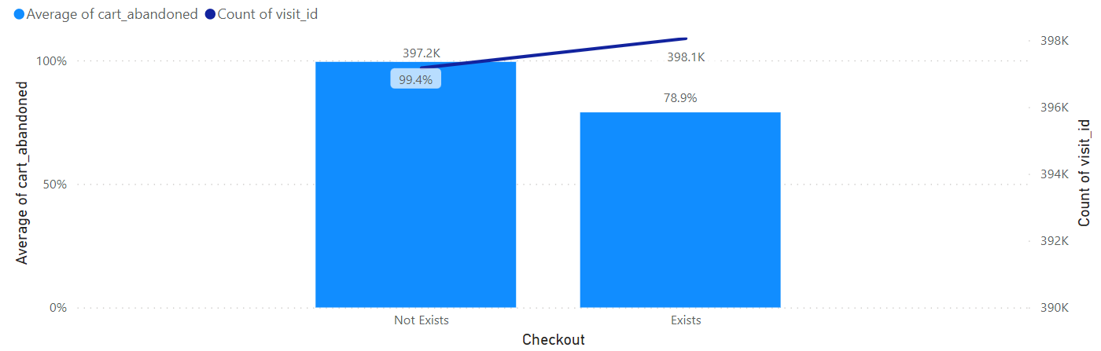
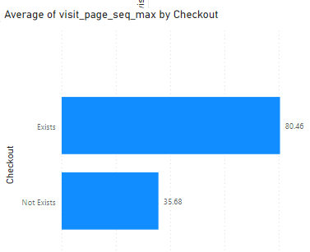
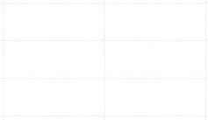
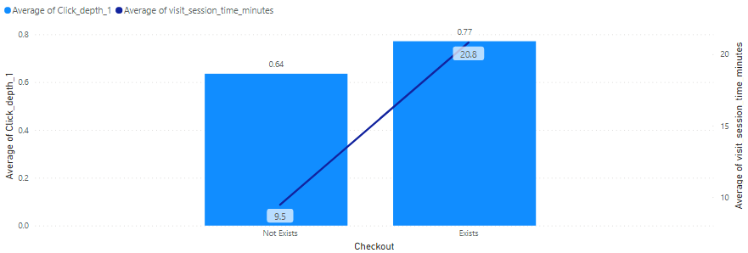
A VISIT-CART IS ~99.4% ABANDONED IF THERE IS NO CHECKOUT EVENT IN THE VISIT
~50% of the visits don’t have a checkout event in them
Visits without checkouts have low session time and session activities
Visits without checkouts have higher click-depth

Slide 11
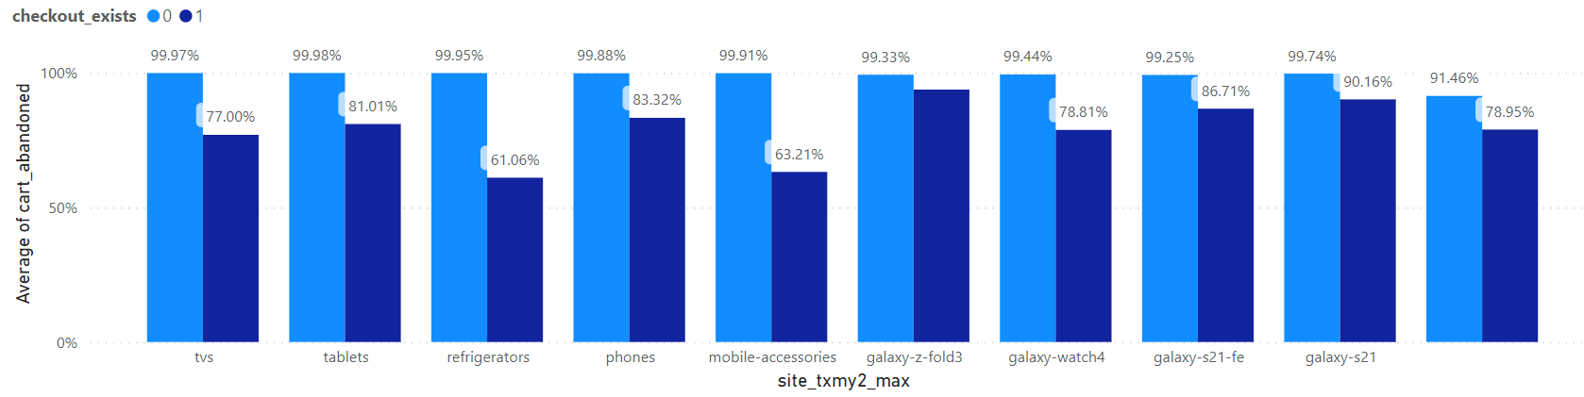
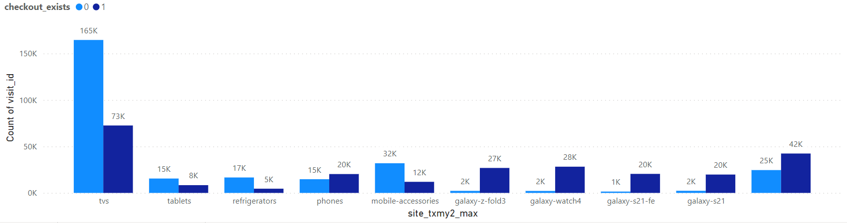
Visits in the tv and tablet taxonomy without a checkout have a 99.9% Car
Galaxy-s21 has 90% CAR even in visits where checkout exists
~90% of all the Galaxy visits have a checkout flag in them

Slide 12
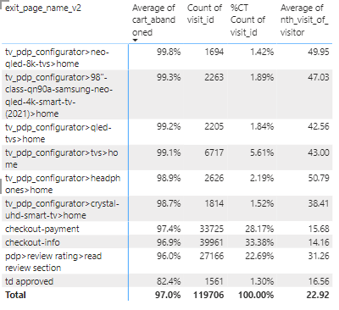
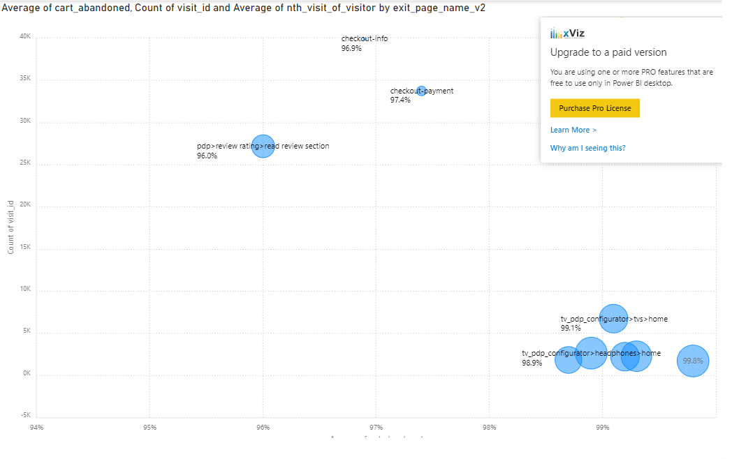
Premium TV`s have high CAR with highly interested Customers
The visitors of high value TV`s have visited Samsung.com over ~40 times and still have high CAR.
Notes:
Brittany
For the visual on the lefthand side, the exit_page_name_v2s are plotted based on the distinct count of visit_id and the average cart_abandoned. The size of the bubble represents the average of the nth_visit_of_visitor variable which is the number of times that a distinct visitor came to this page. Looking at the top 10 visited exit_page_name_v2's, we see visitors who exited the TV pdp configurator pages have the highest cart abandonment rate and those pages appear in the top 6 of 10 exited pages. The visitors of high value TV`s have visited Samsung.com over ~40 times and still have high CAR.

Slide 13
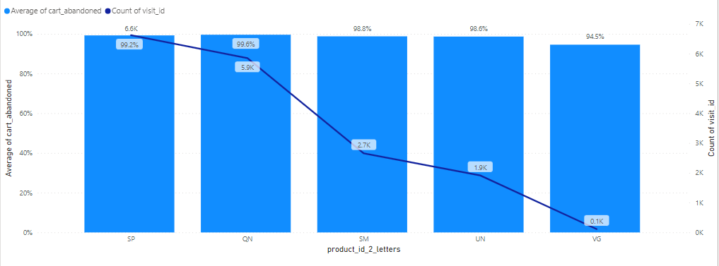
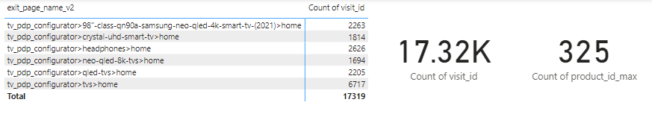
Highly abandoned products among tv landing page visitors
Samsung has 17.3K visits as opportunity to reduce cart abandonment by either offering discounts or alternate products.
Notes:
Brittany
There are 17,319 distinct visitors who exited from six ‘tv_pdp_configurator’ pages and those visitors had the highest CAR. We've grouped the products by the first two digits of the product_id to segment the number of visits and CAR. There are 325 unique product IDs total. The top abandoned product with the prefix 'SP' only has 3 unique IDs. There is opportunity to reduce cart abandonment by either offering discounts or alternate products.

Slide 14
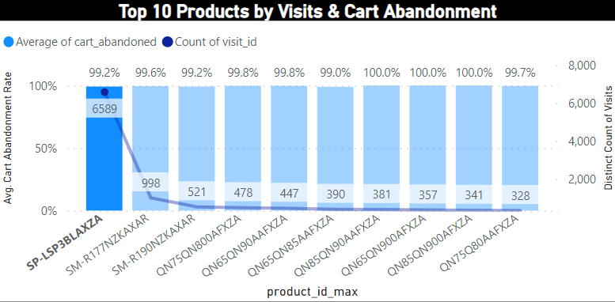
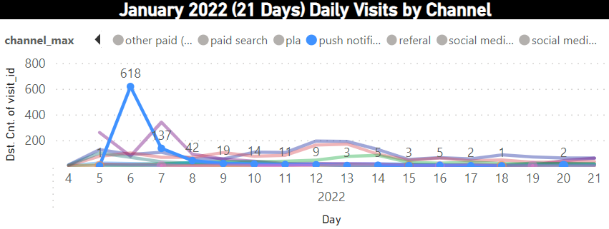
Highly abandoned products among tv landing page visitors cont.
Product
SP-LSP3BLAXZA (Free style Projector) had the highest number of visits with 99.2% CAR.
Looking at these
visitors by channel, we see 618 (9.4%) were from push notifications on January 6th.
Notes:
Brittany
The top product ID abandoned is SP-LSP3BLAXZA (Free style Projector) (6,589 visits, 99.2% CAR).
Looking at these visitors by channel, we see 618 (9.4%) were from push notifications on January 6th and their carts were 100% abandoned.
Although almost 10% of visitors for this product engaged in the push notifications, it was not enough for them to complete the purchase for this item.

Slide 15
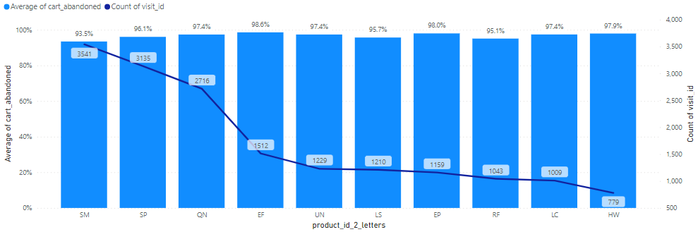
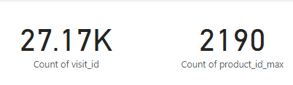
96% of ~27k visits were abandoned after checking the review section
The top products abandoned are – SM, SP, QN, EF and UN.
Improving the review sections could help in reducing CAR in this section.
Notes:
Brittany
Another exit page that had a high number of visits on average (~31) was the 'pdp>review rating>read review section' page. The top products abandoned are – SM, SP, QN, EF and UN.
Improving the review sections could help in reducing CAR in this section.
Samsung could look into these reviews and ask: Are there any reviews that are unnecessarily bad or that have a particularly negative sentiment? Are there reviews that identify a product defect or quality control concern?

Slide 16
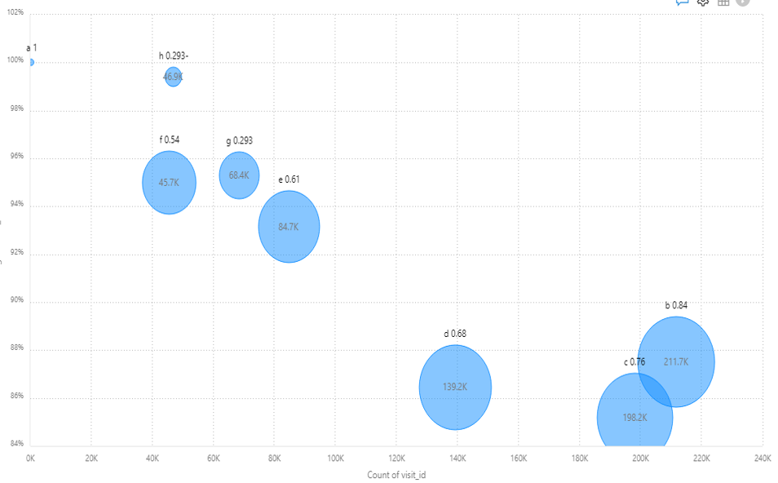
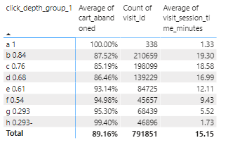
Visits with higher click depth* have lower CAR and higher Average session time
* Click Depth = 1-(#page views / # Activities)
Different bubbles in the above chart can be considered as differently behaving customer segments. Customer segments where click depth is 0.61- spend relatively lesser time on the session and higher CAR. These segments are window shopping about various products. They could be nudged with better product recommendations.

Slide 17
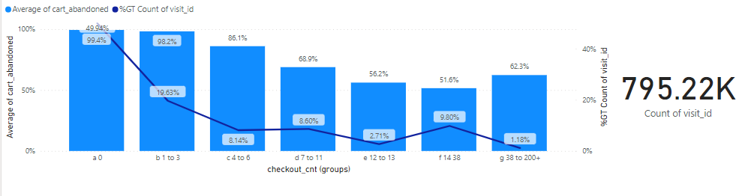
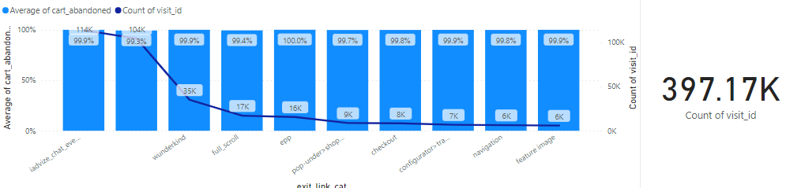
Visits with checkouts <4 have 98% CAR
~114K visits had 0 checkouts and mostly chat with iadvize and leave.
~35K visits also left from wunderkind link category.
~104K visits where there were 0 checkouts did not have a link category recorded on exit
Top exit link categories where checkouts are <4

Slide 18
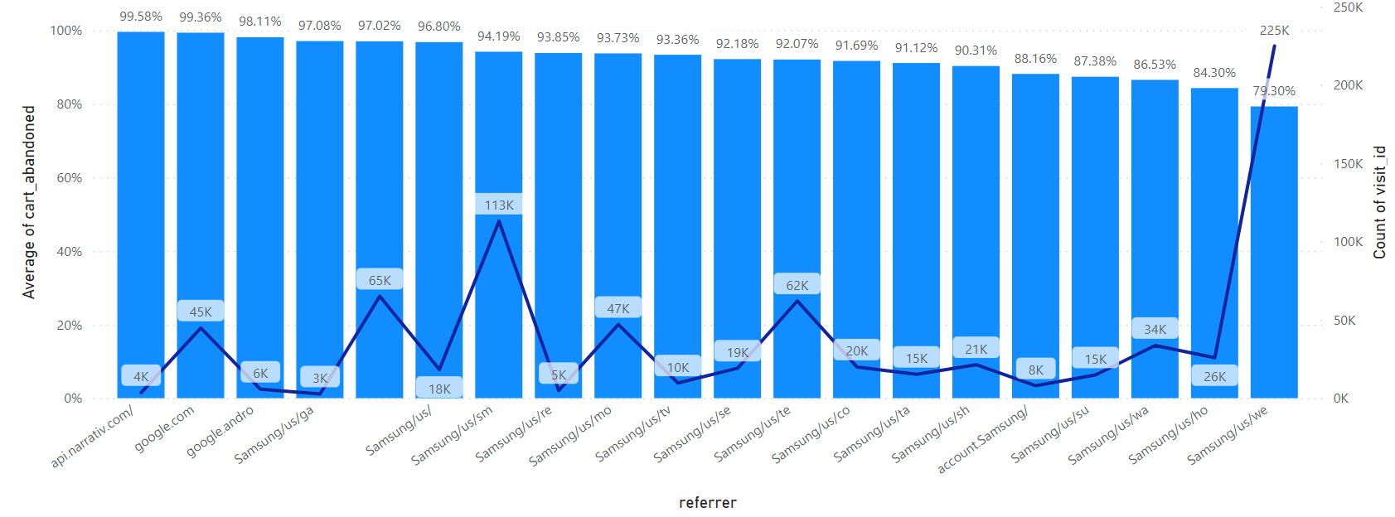
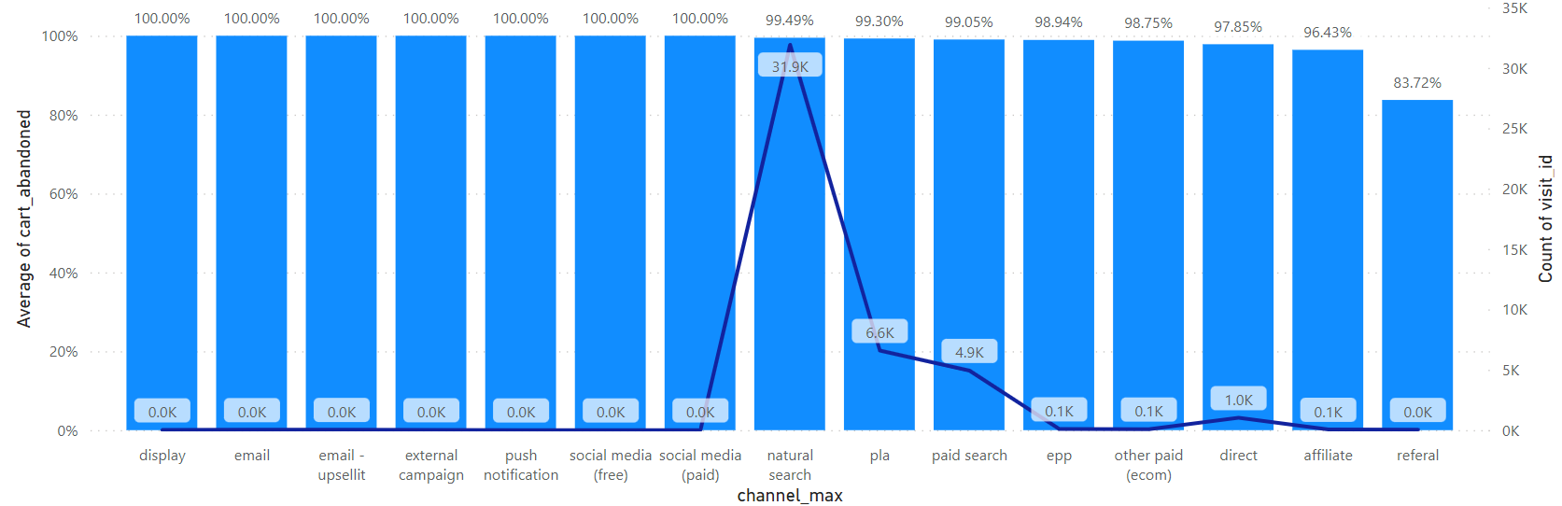
Visits coming from google referrer have high car
Major channels for google referrer are natural search, pla and paid search
In the next slide we look at the entry pages for visits that came through these channels to understand any reason for high CAR
Notes:
Get full name of page. (remove uofl2022.org)

Slide 19
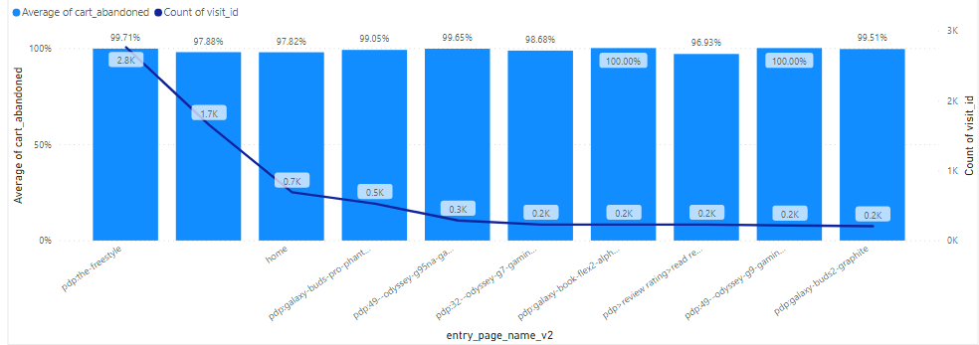
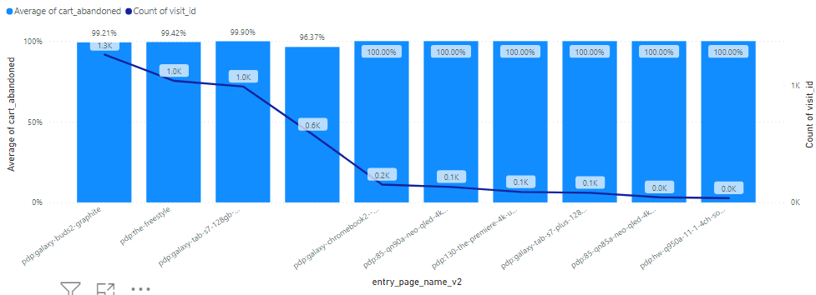
Popular Entry pages for natural and paid search
Natural Search
Most google based searches seem to land on a pdp page.
Yet there is a high CAR
Paid Search
Notes:
Get full name of page. (remove uofl2022.org)

Slide 20
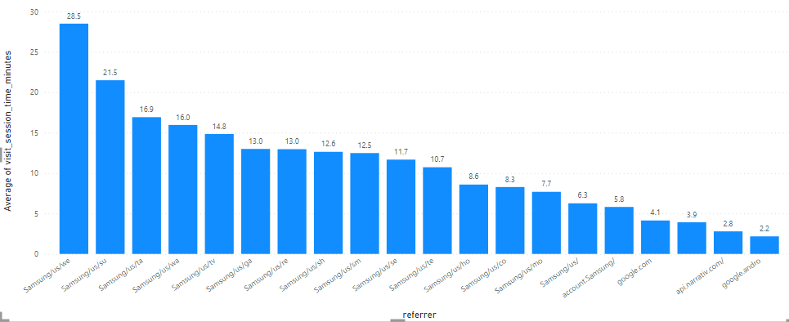
People landing on Samsung.com through google seem to spend very less time on the visit
Samsung does not seem to be a preferred destination when people search on google and land on Samsung website as a result
Investigation on relevance of the landing pages when visitors come from google should be conducted
Notes:
Get full name of page. (remove uofl2022.org)

Slide 21
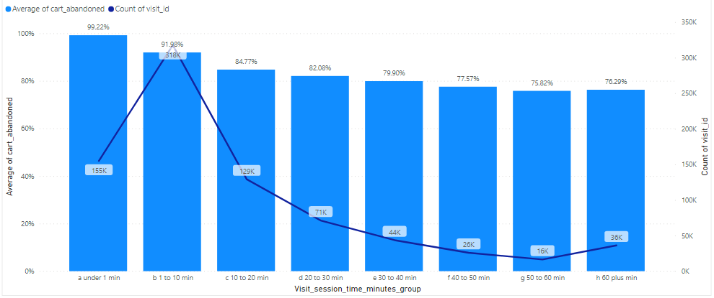
0 – 10 Minutes Visit session time visits accounts for almost 60% of the total visits.
Average Cart Abandonment Rate & Count of Visit by Session Time
Under 1 minutes and 1–10 Minutes groups are also the only 2 groups average above 90% Cart Abandonment Rate.
Cart Abandonment rate still higher than 80% when the customers are spending 20+ minutes in the session.

Slide 22
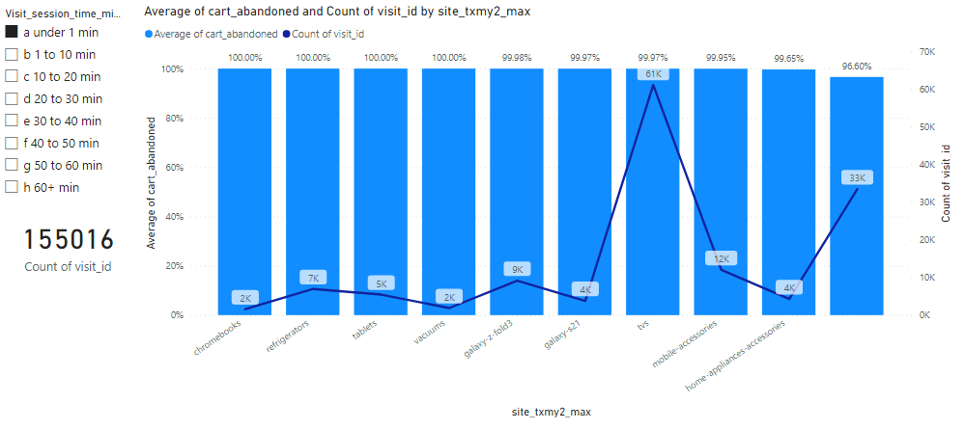
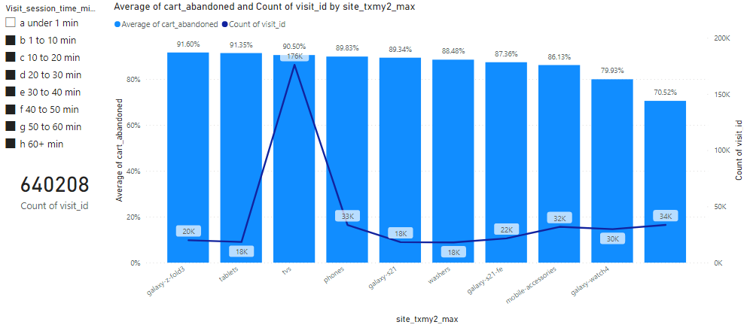
TV`s are the highest visited section irrespective on time spent on a visit
Chromebooks, Refrigerators, Tablets and Vacuums appear only in the under 1minute visits and show a 100% CAR

Slide 23

BUSINESS OPPORTUNITIES ARE LIKE BUSES. THERE'S ALWAYS ANOTHER ONE COMING.​
Richard Branson

Slide 24

Key takEaways
Visits where a checkout event occurs have a high potential of a purchase. Repeat visits are more likely abandoned. Incentivize and cross-sell on repeat visits
TV product landing page has ~99% CAR but visitors visit ~40 times on an average. Better use the repeat visits to cross sell and innovate on TV offers to increase purchase interest
Improving the review sections could help to reduce CAR
High Click-depths show strong relation with low CAR. The UX should be improved to increase customer engagement on the website
Understand why most visitors leave from iadvize and wunderkind link categories
Visits coming from google search seem to last only for ~4 minutes on average. Study the product relevance shown for these visits

Slide 25

THANK YOU

Slide 26
Appendix

Slide 27
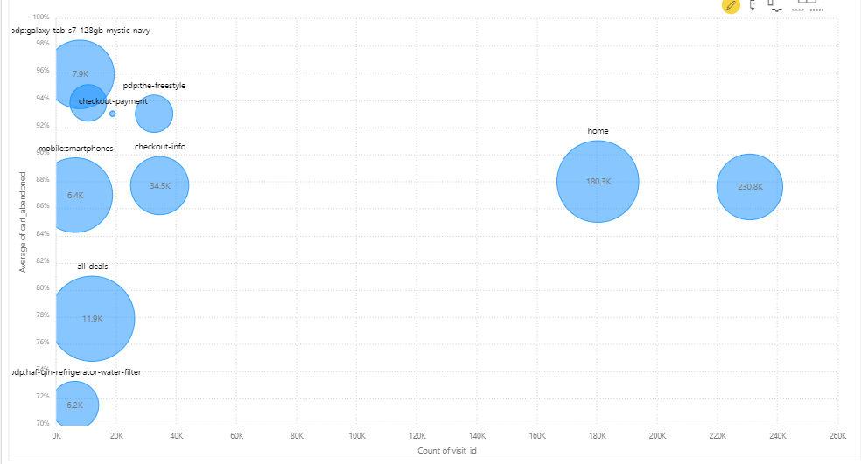
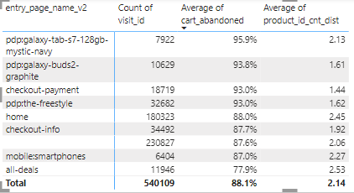
Entry page VS CAR
Visits entering through pdp pages seem to have higher CAR
This also correlates with visits coming through google landing mostly on pd pages and highly abandoned
Notes:
Split this chart by the channel

Slide 28
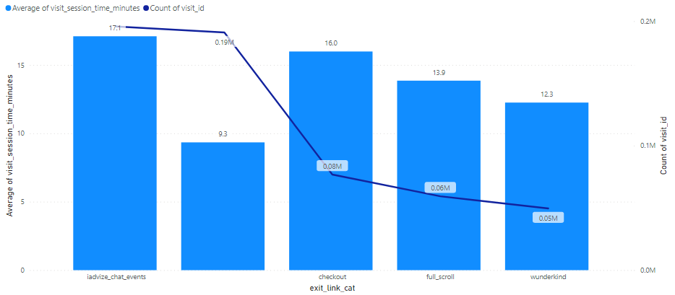
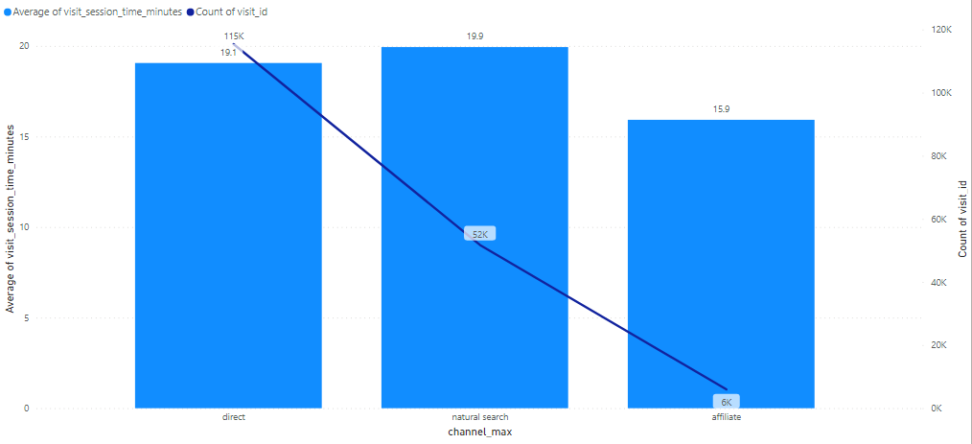
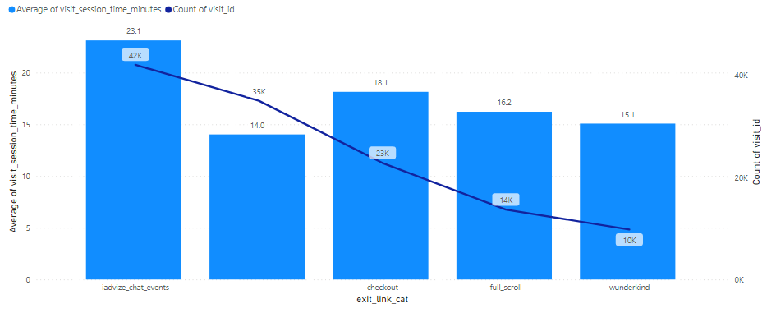
Visits entered from home
Most visits which enter through home, come through direct, natural search and affiliate channels
They are more likely to exit with an iadvize link than other channel visits
Samsung should look into why natural searches are landing on home page
Notes:
Split this chart by the channel

Slide 29
Modeling Approach & results
We Follow an iterative elimination approach using Random Forest to arrive at most important sets of variables in decreasing order
As we remove highly important drivers from initial iterations, we get rid of some of the obvious explainers and arrive at some actionable explainers of CAR
Iteration | Model | Train_accuracy | Train_precision | Train_recall | Train_f1 | Test_accuracy | Test_precision | Test_recall | Test_f1 | Top_1_explainer | Top_2_explainer | Top_3_explainer | Top_4_explainer | Top_5_explainer
Iter 1 | rf_Target_enc | 0.999601101 | 0.999547409 | 1 | 0.999773653 | 0.967144453 | 0.970104787 | 0.993477117 | 0.981651853 | exit_page_name | paymentmethod_cnt_dist | checkout_cnt | finalpayment_cnt_dist | exit_page_max
Iter 2 | rf_Target_enc | 0.998244844 | 0.998015873 | 1 | 0.999006951 | 0.949180938 | 0.952845528 | 0.991330091 | 0.971706913 | exit_page_name_v2 | exit_event_name | checkout_exists | Checkout | wallet_card
Iter 3 | rf_Target_enc | 0.996729028 | 0.996310959 | 1 | 0.998152071 | 0.921909903 | 0.925526654 | 0.990893689 | 0.957095372 | product_id_max | exit_link_id | exit_link_cat | entry_page_name | visit_session_time
Iter 4 | rf_Target_enc | 0.993019267 | 0.992208839 | 0.999954874 | 0.996066797 | 0.909810127 | 0.912128592 | 0.992895016 | 0.950799695 | product_id_cnt_dist | test_Type_max | exit_page_type | entry_page_name_v2 | site_txmy2_max
Iter 5 | rf_Target_enc | 0.987275121 | 0.985893487 | 0.99986418 | 0.992829688 | 0.900316456 | 0.90498607 | 0.991370238 | 0.946210637 | nth_visit_of_visitor | event_name_cnt_dist | event_name_cnt | referrer_max | entry_link_id
Iter 6 | rf_Target_enc | 0.977541984 | 0.975277631 | 0.999909637 | 0.987440045 | 0.89538347 | 0.900586482 | 0.99048324 | 0.943398127 | entry_event_name | click_depth | visit_page_seq_max | pageview_page_event_cnt | cart_visit_cnt
Entry event name | 0.041293252
Click depth | 0.035051258
Visit page seq max | 0.033091462
# Pageview page event | 0.032407232
# Cart visit | 0.031901372
# page name | 0.030875299
# visit page seq | 0.030236624
# distinct page name | 0.030057439
# Link category | 0.028418682
# distinct Page name | 0.027955451
# Click page event | 0.027925316
# distinct Link category | 0.027583978
# page name | 0.02751047
# link id | 0.027311672
# distinct link id | 0.026641932
Time of Day | 0.025815048
Browser name | 0.023871073

Slide 30
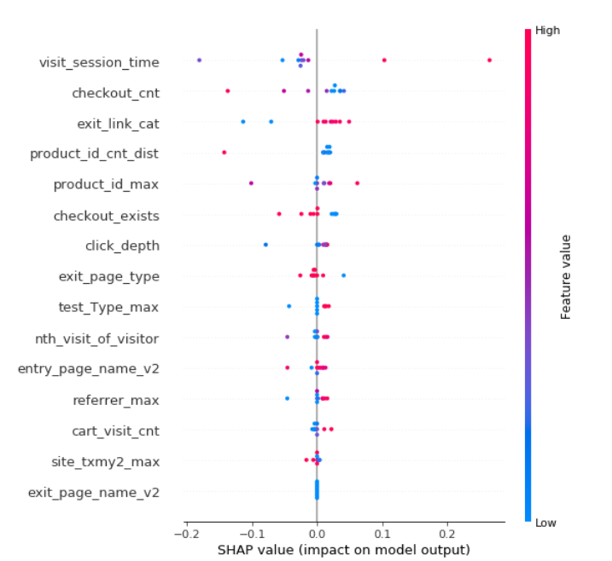
Modeling Approach & results – Random forest
Metric | Result
Accuracy | 94.5%
Precision | 95.3%
Recall | 98.7%
F1 | 96.9%
feature | Importance
checkout_cnt | 0.25
exit_page_name_v2 | 0.11
exit_link_cat | 0.11
product_id_max | 0.09
checkout_exists | 0.08
visit_session_time | 0.06
click_depth | 0.04
test_Type_max | 0.04
product_id_cnt_dist | 0.04
nth_visit_of_visitor | 0.04
entry_page_name_v2 | 0.04
cart_visit_cnt | 0.03
site_txmy2_max | 0.03
referrer_max | 0.03
exit_page_type | 0.03

Slide 31
Logistic regression to understand direction of impact on car
Metric | Result
Accuracy | 90.12%
Precision | 91.05%
Recall | 98.42%
F1 | 94.59%
feature | beta | abs_beta
test_Type_max_motopay_by_link | -2.60 | 2.60
checkout_exists | -2.58 | 2.58
test_Type_max_motopay | 2.49 | 2.49
exit_page_type_my orders|my orders | -1.54 | 1.54
referrer_max_https://www.verizon.com/ | -1.22 | 1.22
site_txmy2_max_home-appliances-accessories | -1.12 | 1.12
test_Type_max_Not available | 1.09 | 1.09
test_Type_max_experiment | 1.08 | 1.08
exit_page_type_td financing | 0.98 | 0.98
exit_page_type_affirm financing | -0.94 | 0.94
exit_page_type_b2c|search results | 0.91 | 0.91
exit_page_type_my orders|order details | -0.89 | 0.89
exit_page_type_home | 0.89 | 0.89
click_depth | 0.86 | 0.86
exit_page_type_my orders|guest order | -0.85 | 0.85
exit_page_type_configurator>home | 0.84 | 0.84
referrer_max_Not available | 0.81 | 0.81
referrer_max_https://www.uofl2022.org/us/te | 0.77 | 0.77
referrer_max_https://www.uofl2022.org/us/sm | 0.75 | 0.75
exit_page_type_Not available | 0.73 | 0.73
referrer_max_https://www.uofl2022.org/us/es | 0.59 | 0.59
site_txmy2_max_Not available | -0.55 | 0.55
test_Type_max_normal | 0.54 | 0.54
site_txmy2_max_offer-program | -0.54 | 0.54
exit_page_type_product finder | 0.53 | 0.53
site_txmy2_max_galaxy-z-fold3 | 0.49 | 0.49
referrer_max_https://www.uofl2022.org/us/ta | 0.47 | 0.47
referrer_max_https://www.joinhoney.com/ | -0.47 | 0.47
site_txmy2_max_us:tvs:the-frame | 0.45 | 0.45
site_txmy2_max_vacuums | -0.45 | 0.45

Slide 32
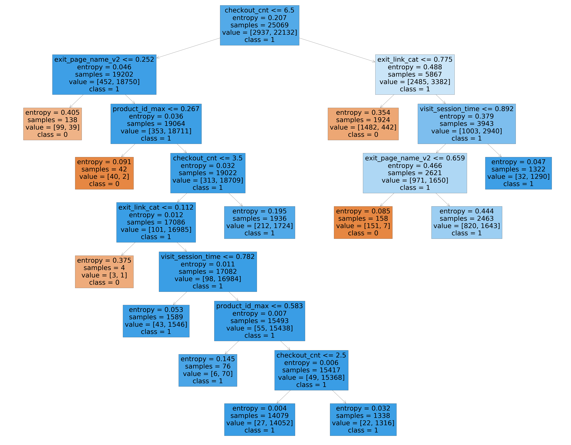
Model insights – (Interaction of Checkouts, exit links categories, session time, page name, product id)

Slide 33
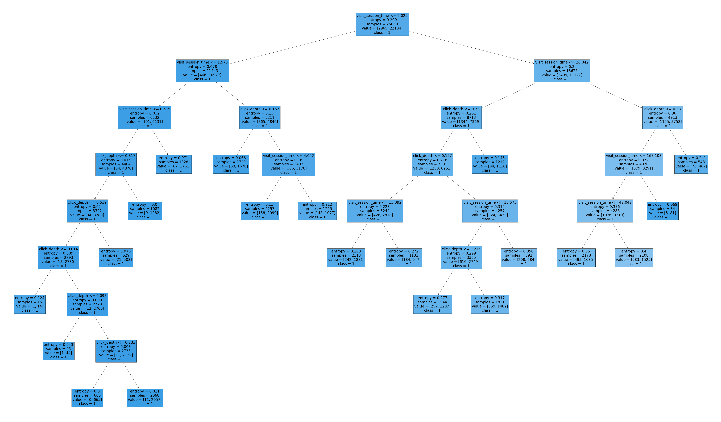
Model insights – (Interaction of click depth and session time)

Slide 34
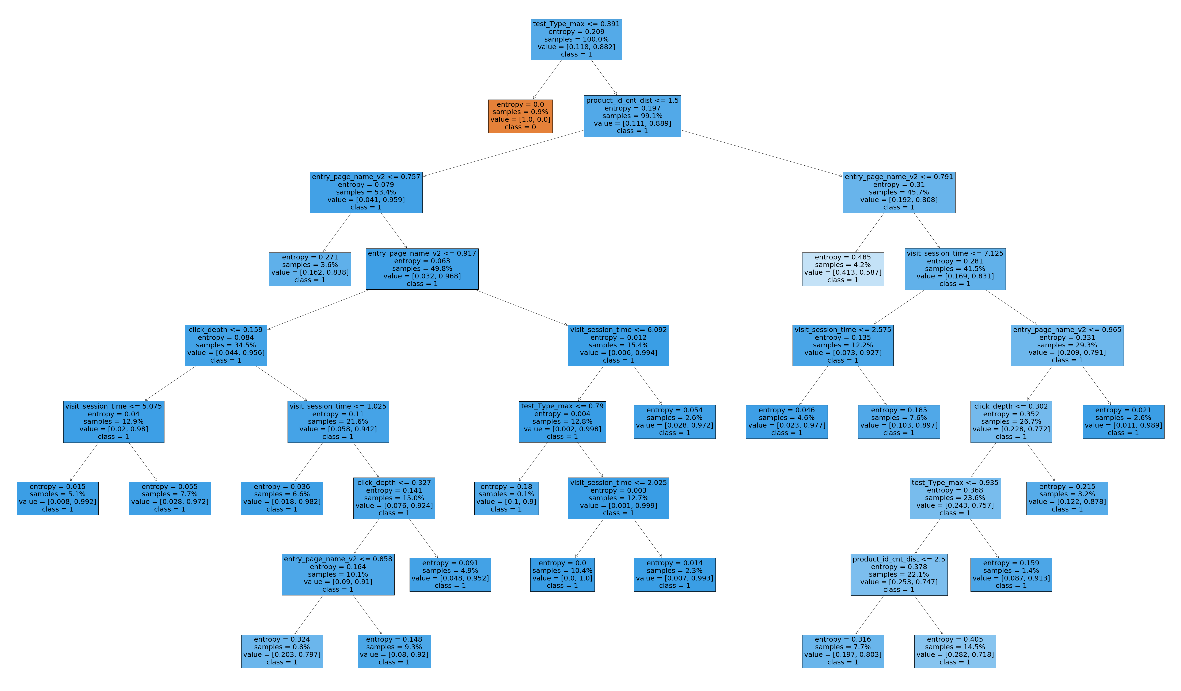
Model insights – (Interaction of session time, # products, click depth, test type, entry page)

Slide 35
Visits with no product id in traffic data may be overstating abandonment rate in reports
There are 40197(~56%) visits out of 71252 visits on 2022-01-01 where the visit does not have any product_id but has carts in them. When we check the cart-line table, there are product_id for these carts. Also, there seems to be orders against them. These visits don’t have any order corresponding to them in the traffic data leading to show 100% abandonment rate.
Insights for Data Engineers & Reporting teams

Slide 36
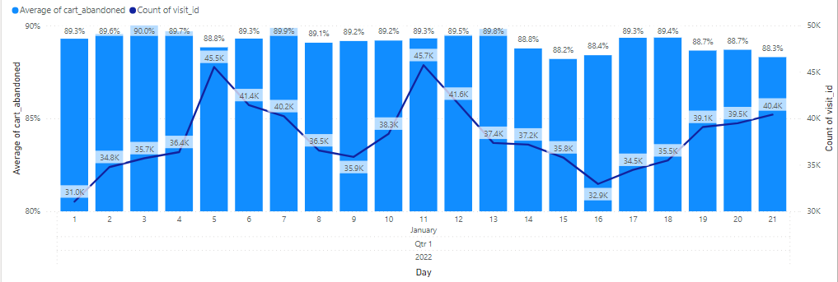
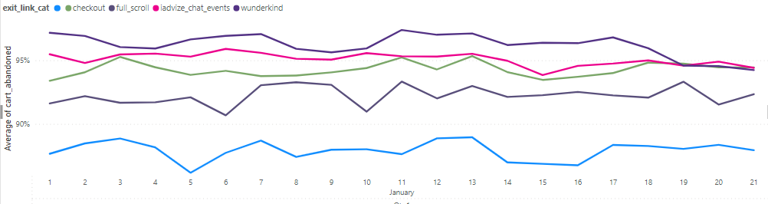
Daily car and visit volume

Slide 37
Daily car and visit volume

Slide 38
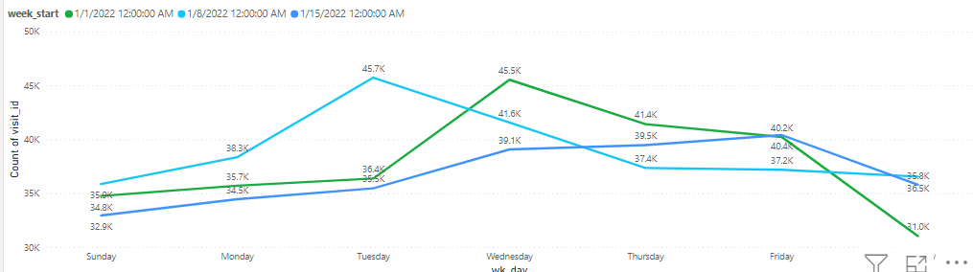
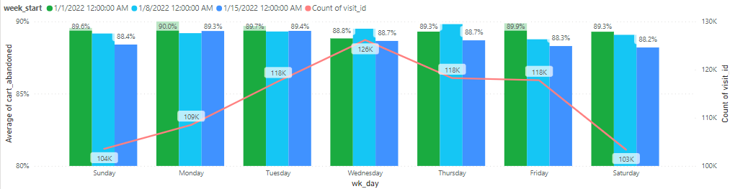
Day of week car and visit volume

Slide 39
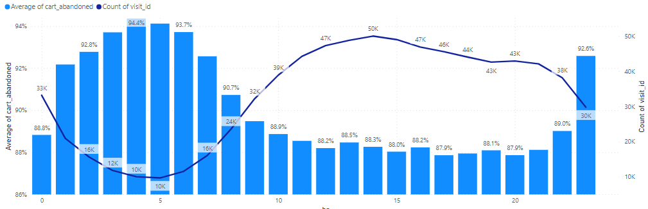
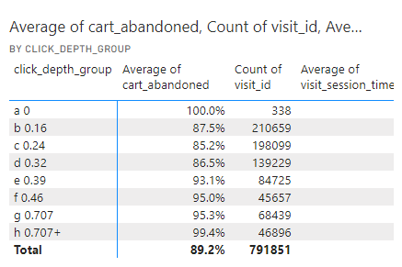
Time of Day car and visit volume

